Slide 1

DATA SCIENCE INTERNSHIP Session 7
HDLC TECHNOLOGIES

Slide 2
What is Matplotlib?
Matplotlib is a basic graph plotting library in python that serves as a visualization utility.
Matplotlib was created by John D. Hunter.
Matplotlib is open source and we can use it freely.
Matplotlib is mostly written in python, a few segments are written in C.

Slide 3
Installation of Matplotlib
pip install matplotlib

Slide 4
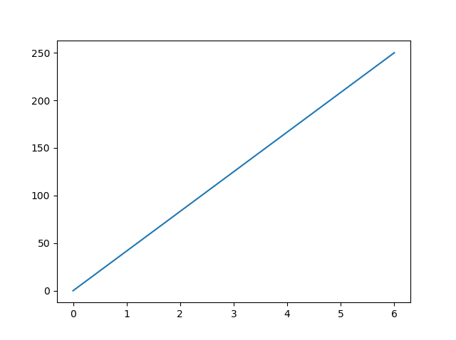
Matplotlib Pyplot
import matplotlib.pyplot as plt import numpy as np xpoints = np.array([0, 6]) ypoints = np.array([0, 250]) plt.plot(xpoints, ypoints) plt.show()

Slide 5
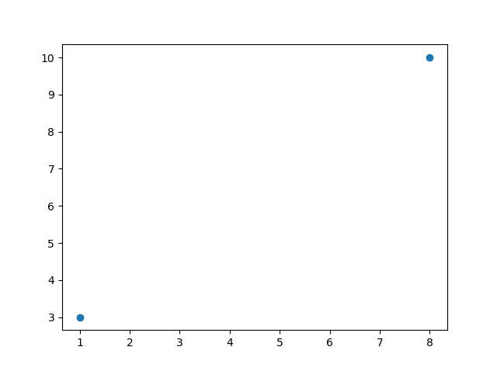
Plotting Without Line
import matplotlib.pyplot as plt import numpy as np xpoints = np.array([1, 8]) ypoints = np.array([3, 10]) plt.plot(xpoints, ypoints, 'o') plt.show()

Slide 6
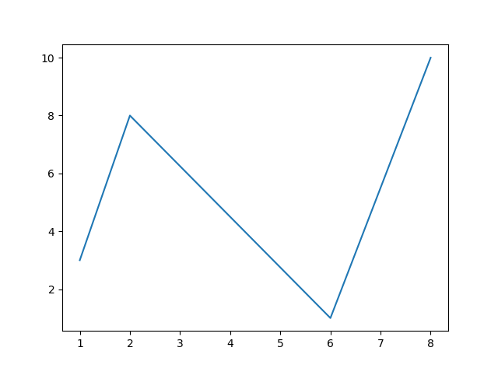
Multiple Points
import matplotlib.pyplot as plt import numpy as np xpoints = np.array([1, 2, 6, 8]) ypoints = np.array([3, 8, 1, 10]) plt.plot(xpoints, ypoints) plt.show()

Slide 7
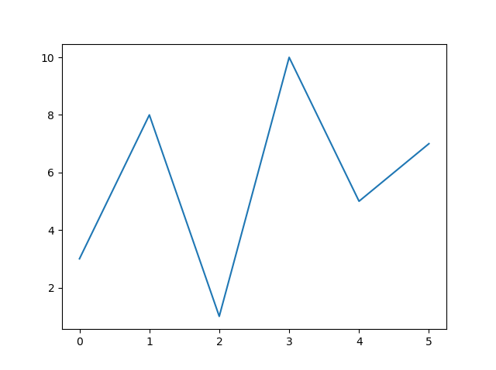
Default X-Points
import matplotlib.pyplot as plt import numpy as np ypoints = np.array([3, 8, 1, 10, 5, 7]) plt.plot(ypoints) plt.show()

Slide 8

Matplotlib Markers
import matplotlib.pyplot as plt import numpy as np ypoints = np.array([3, 8, 1, 10]) plt.plot(ypoints, marker = 'o') plt.show()

Slide 9
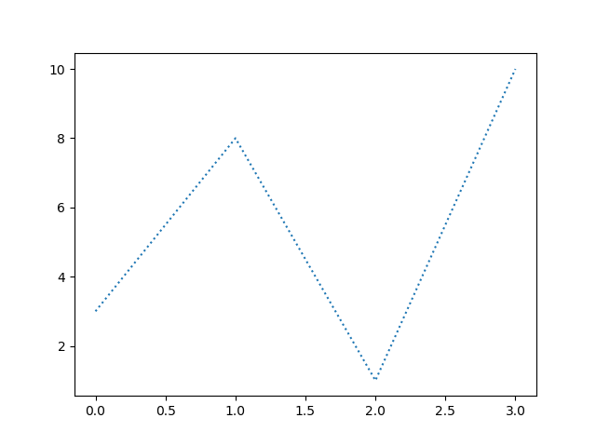
Matplotlib Line
import matplotlib.pyplot as plt import numpy as np ypoints = np.array([3, 8, 1, 10]) plt.plot(ypoints, linestyle = 'dotted') plt.show()
Result:

Slide 10
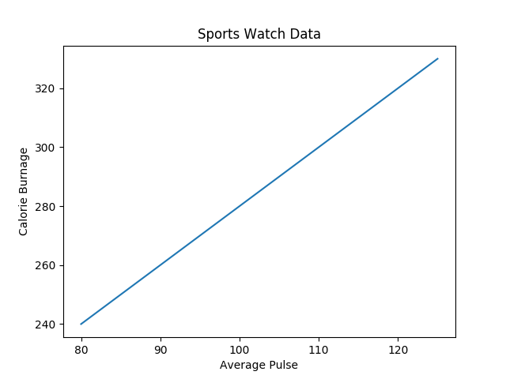
Matplotlib Labels and Title
import numpy as np import matplotlib.pyplot as plt x = np.array([80, 85, 90, 95, 100, 105, 110, 115, 120, 125]) y = np.array([240, 250, 260, 270, 280, 290, 300, 310, 320, 330]) plt.plot(x, y) plt.title("Sports Watch Data") plt.xlabel("Average Pulse") plt.ylabel("Calorie Burnage") plt.show()

Slide 11

Matplotlib Adding Grid Lines
import numpy as np import matplotlib.pyplot as plt x = np.array([80, 85, 90, 95, 100, 105, 110, 115, 120, 125]) y = np.array([240, 250, 260, 270, 280, 290, 300, 310, 320, 330]) plt.title("Sports Watch Data") plt.xlabel("Average Pulse") plt.ylabel("Calorie Burnage") plt.plot(x, y) plt.grid() plt.show()

Slide 12
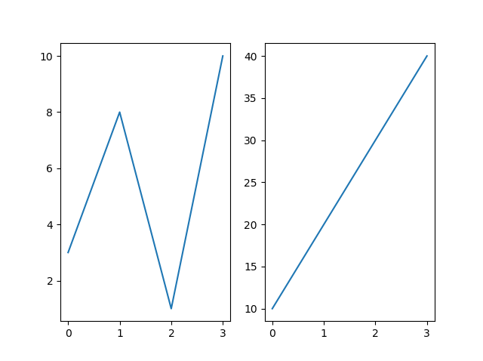
Matplotlib Subplot
import matplotlib.pyplot as plt import numpy as np #plot 1: x = np.array([0, 1, 2, 3]) y = np.array([3, 8, 1, 10]) plt.subplot(1, 2, 1) plt.plot(x,y) #plot 2: x = np.array([0, 1, 2, 3]) y = np.array([10, 20, 30, 40]) plt.subplot(1, 2, 2) plt.plot(x,y) plt.show()

Slide 13
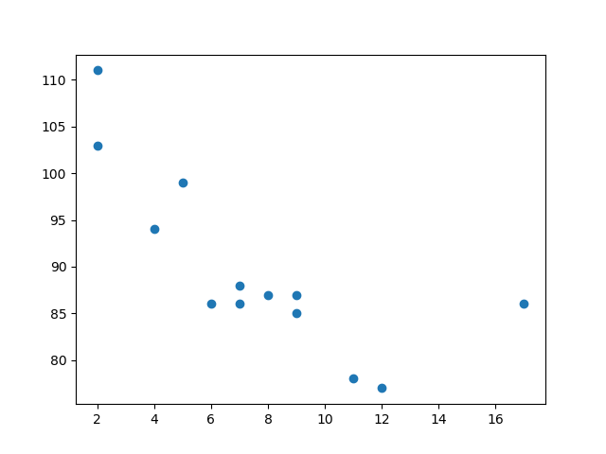
Matplotlib Scatter
import matplotlib.pyplot as plt import numpy as np x = np.array([5,7,8,7,2,17,2,9,4,11,12,9,6]) y = np.array([99,86,87,88,111,86,103,87,94,78,77,85,86]) plt.scatter(x, y) plt.show()

Slide 14
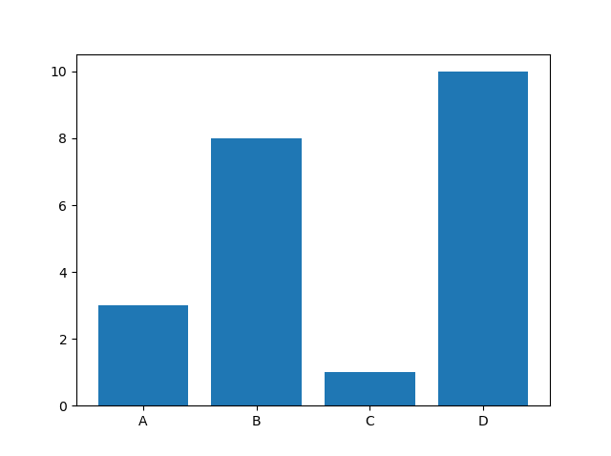
Creating Bars
import matplotlib.pyplot as plt import numpy as np x = np.array(["A", "B", "C", "D"]) y = np.array([3, 8, 1, 10]) plt.bar(x,y) plt.show()

Slide 15
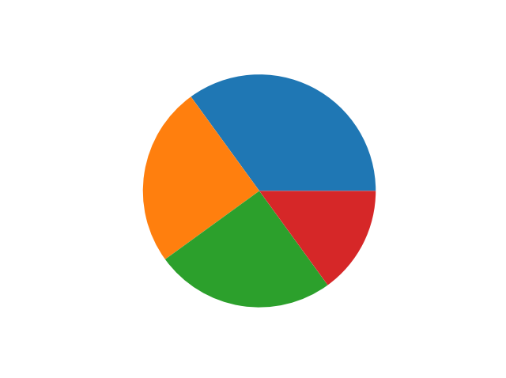
Matplotlib Pie Charts
import matplotlib.pyplot as plt import numpy as np y = np.array([35, 25, 25, 15]) plt.pie(y) plt.show()

Slide 16
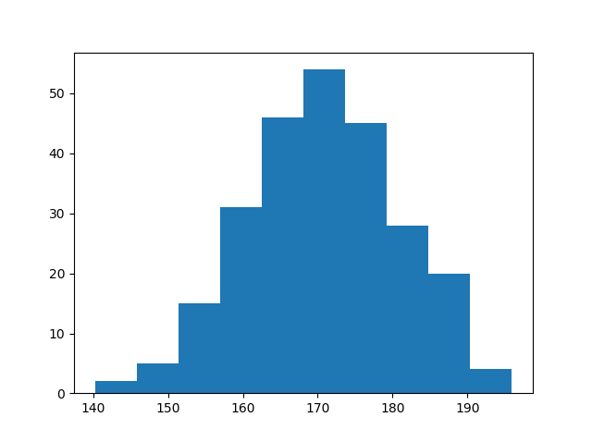
Matplotlib Histograms
import matplotlib.pyplot as plt import numpy as np x = np.random.normal(170, 10, 250) plt.hist(x) plt.show()

